Slide 1

IQueryable vs. IEnumerable
SECTION 5

Slide 2
IEnumerable Explained & Usage
IQueryable vs. IEnumerable
Video 5.1

Slide 3
IEnumerable
Interface
Single method [GetEnumerator()] for iterating a collection of objects
Base interface for all non-generic collection
Provides For…Each mechanism
Extension methods (System.Linq):
AsParallel() – Query Parallization
AsQueryable() – Converts to IQueryable
Cast<TResult>() – Cast element of IEnumerable to specific type
OfType<TResult>() – Filters elements of IEnumerable

Slide 4
IQueryable Explained & Usage
Next Video

Slide 5
IQueryable Explained & Usage
IQueryable vs. IEnumerable
Video 5.2

Slide 6
IQueryable
Deferred Execution (like IEnumerable)
Server-Side Execution if possible (vs. IEnumerable Client-Side)
Filters applied BEFORE data is retrieved (Where clause)
Enables LINQ-To-SQL : Apply filters at DB
Faster (reduced dataset)
Enables Pagination – Get only the data page you want
Using Skip().Take()
Uses Expression Trees (vs Function based)
Faster – Convert directly into SQL via E.F. and Link2SQL ORMs

Slide 7
Read Related Data
Next Video

Slide 8
Read Related Data
IQueryable vs. IEnumerable
Video 5.3

Slide 9
Include
Notes:
Something that needs to grab the viewers attention!!

Slide 10
ThenInclude
Notes:
Something that needs to grab the viewers attention!!

Slide 11
Boundary Bleed ::: Layering
Next Video

Slide 12
Boundary Bleed ::: Layering
IQueryable vs. IEnumerable
Video 5.4

Slide 13
N-Tier Architecture Pattern [Separation of Conerns]
Notes:
Something that needs to grab the viewers attention!!

Slide 14
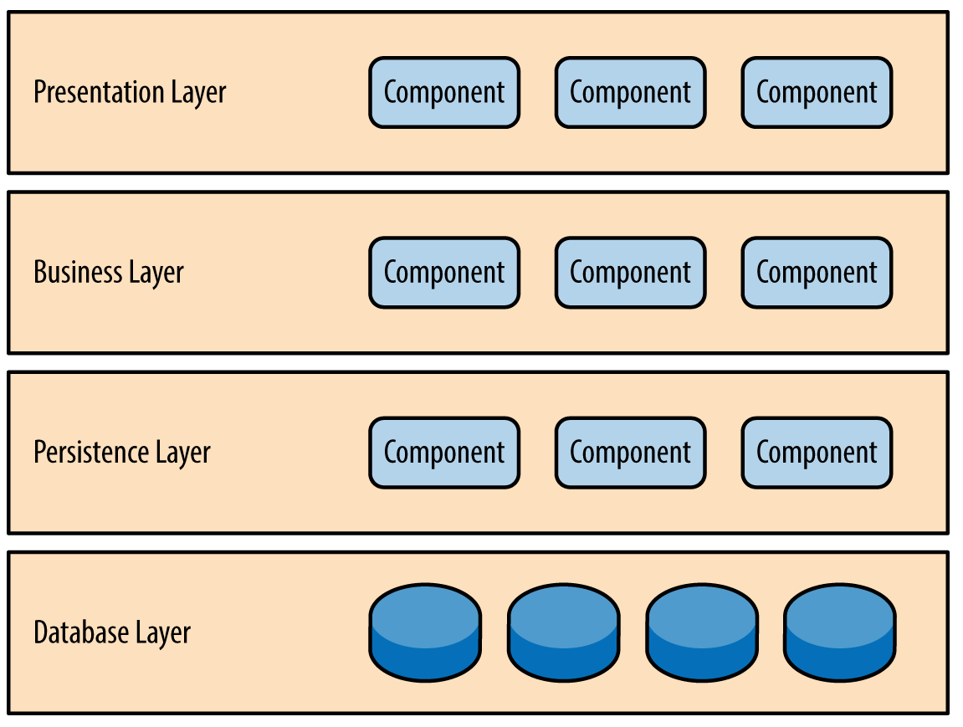
Application Architecture

Slide 15
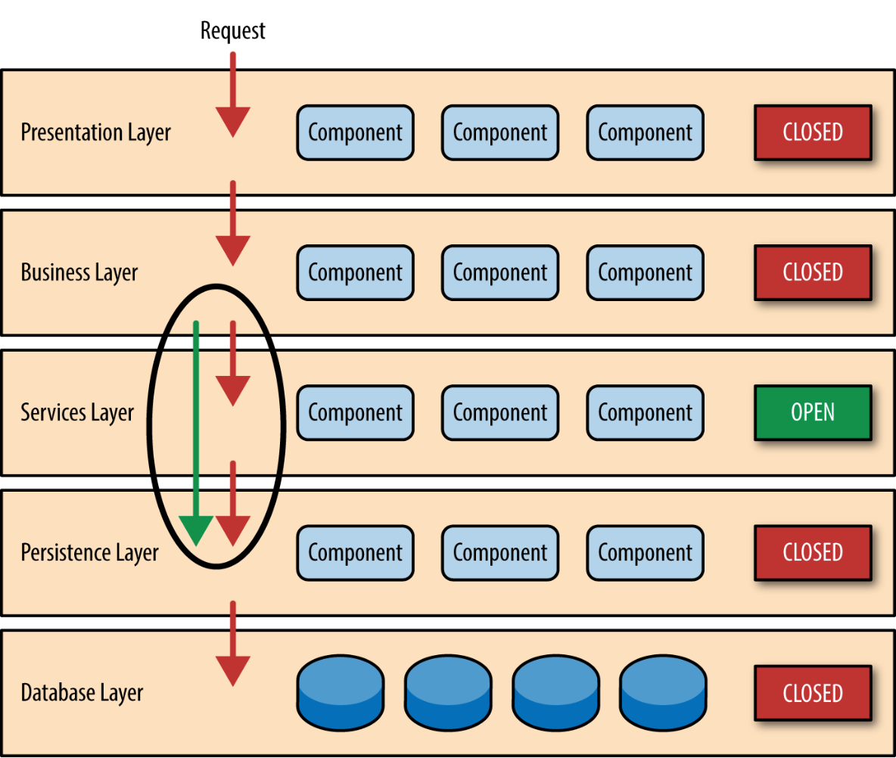
Boundary Bleed
BLEED

Slide 16
80 / 20 Rule [Sinkhole anti-pattern]
Notes:
Something that needs to grab the viewers attention!!

Slide 17
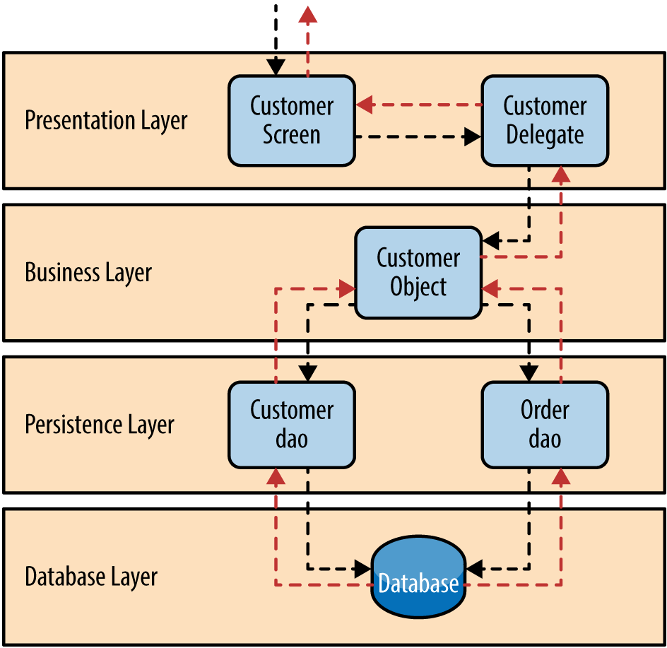
Pattern Example

